Slide 1
Q & A on APES 110 Guidelines
Manoj Abichandani, Eric Taylor & Dennis Wright

Slide 2
House Keeping - Audio
If Computer sound is not audio able
Phone the number on your panel
Enter Access Code

Slide 3
House Keeping – Hand Out
Copy of this Presentation can be downloaded
From the Panel

Slide 4
House Keeping – Questions on this Presentation
If you have any Questions on this Presentation
Type in your questions in the panel
Speaker will answer all your questions
after the presentation

Slide 5
Dennis Wright B. Bus, MIPA, SMSF Auditor
Sole Practitioner Since 1985
100% into SMSF Audit since 2007
Audit close to 300 SMSF’s for 9 Accounting Firms

Slide 6
Eric Taylor B Com (Adel), FIPA, CTA, SMSF Auditor eric@aust-smsf-audits.net.au
Working in public practice 30 years
Auditing SMSF for last 10 years
Came back from Semi – Retirement to handle the SMSF rush
Audits over 250 Funds

Slide 7
Disclaimer of Legal & Financial Advice – Educational Purpose Only
Statement
This paper represents the opinion of the author (s) and not necessarily those of Deed Dot Com Dot Au Pty Ltd. The contents are for general information only. They are not intended as professional advice - for that you should consult a Accountant or other suitably qualified professional. Deed Dot Com dot Au Pty Ltd expressly disclaims all liability for any loss or damage arising from reliance upon any information in this presentation.
Disclaimer
The information contained in this presentation is based on the understanding of the author has of the relevant Australian laws as at 28th April 2021. As these laws are subject to change you should refer to ATO’s website or talk to a professional adviser for the most up-to-date information. The information is for adviser use only and is not a substitute for investors seeking advice. While all care has been taken in the preparation of this document (using sources believed to be reliable and accurate), no person, including Deed Dot Com Dot Au Pty Ltd, accepts responsibility for any loss suffered by any person arising from reliance on this information. This update is not financial product advice and does not take into account any individual’s objectives, financial situation or needs. Any examples are for illustrative purposes only and actual risks and benefits will vary depending on each investor’s individual circumstances. You should form your own opinion and take your own legal, taxation and financial advice on the application of the information to your business and your clients.

Slide 8
AGENDA
Legislation behind Auditor independence
Auditors Independence – Auditors Views
How to measure Auditors “Independence”
SMSF Auditors Hub

Slide 9
SIS Act - Section 128F(d) SIS Regulations – Reg 9A.06
SISA 128F (d) comply with the auditor independence requirements prescribed by the regulations
SISR 9A.06 Auditor independence requirements
For paragraph 128F(d) of the Act, the auditor independence requirements produced by the Accounting Professional and Ethical Standards Board Limited and set out in the APES 110 Code of Ethics for Professional Accountants (including Independence Standards) are prescribed for all approved SMSF auditors.
APES 110 Amendment – For all audits after 1st Jan 2020

Slide 10
APES 110 is effective since 1st Jan 2020
Since the APES 110 is effective from 1st Jan 2020 – it is quite possible that some auditors are not independent as per the code. Should they be issuing qualified audit reports ?
Dennis
Eric

Slide 11
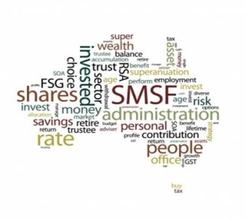
Audit Exchange – Self Interest / Advocacy
Audit Exchange:
In your opinion, would this
exchange work
Under the current APES 110
Dennis
Eric
SMSF Admin Firm
SMSF
Audits
SMSF Admin Firm
SMSF Admin Firm
SMSF Admin Firm

Slide 12
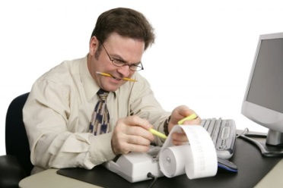
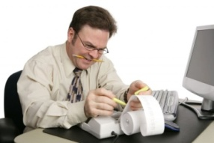
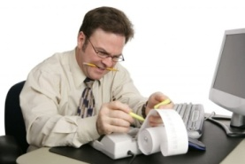
Audit Match – Intimidation Threat
AUDIT POOL
You are matched to one or more firms
Audit Match:
In your opinion, would this
Match work
Under the current APES 110 ?
Does it make it a network firm?
Dennis
Eric
SMSF Administrators
Currently Auditing
250 Funds
SMSF Administrators
SMSF Auditor
Currently Auditing
500 Funds
SMSF Administrators
Currently Auditing
250 Funds

Slide 13
Question: Who should you Invoice ?
If an auditor has not billed the accountant for SMSF audits but bills all the accountants SMSF clients for audits, will that need to change?
Who should we bill:
Trustees
Accountants
Dennis
Eric

Slide 14
Question: Who appoints the Auditor
It appears that the ATO is suggesting that there is an issue with independence where a large number of referrals come from a single source.
The question arises as to whom is the Auditor Responsible and who engages the Auditor surely it is the Trustee to whom we are reporting and if this is the case, then surely independence is maintained notwithstanding that the accounting and tax work is undertaken for numerous funds by a single practice. Please comment.
Dennis
Eric

Slide 15
How much % fee is ok from one referral source
Action
Where a large proportion of an auditor’s fees comes from one referral source, the auditor must evaluate the significance of the threat and apply safeguards when necessary to eliminate the threat or reduce it to an acceptable level
(para AUST R410.3.1)
What % of fee coming from one source are you comfortable with ?
Dennis
Eric

Slide 16
Question: How is independence measured
As an auditor I believe I am fully independent on the audits I do as I have no affiliation with my clients and I have never worked with them or even been in there office. I have 9 clients that give me audits to do though two of the clients are 33% and 50% on the total audits I do based on last years figures. I am still trying to get some new clients. In total last year I did 174 audits
Dennis
Eric

Slide 17
More than 50% coming from one source
SMSF Audits
100 Funds
SMSF Administrators
SMSF Auditor
Currently Auditing
50 Funds
Intimidation
Will be deterred from acting objectively because of actual or perceived pressures from the referral source

Slide 18
Fee Dependency Risk
30%
International Ethics Standards Board
for Accountants (IESBA) non-PIEs
IESB Fees Exposure Draft
15%
Potential threats
to audit clients that are public
interest entities (PIEs)
(R410.4 of APES 110),
20%
May expose the firm to a significant business risk if the client is lost
(APESB) recommended removing the proposed threshold for non-PIE
audit clients and replacing it with the same threshold as PIEs (15%).

Slide 19
Question: How is independence measured
This is not my only my source of income as I run an Accountancy practice with a turnover around $700k and the audits in value are $48k of that turnover.
Dennis
Eric

Slide 20
Question: How is independence measured
I have heard in one of your previous seminars that you should not have more than 20% from one source and does that relate to only audit income or total income of the practice, I cannot find where that is written can you please confirm this for me. I have sent an email to my Accounting Body but yet to receive a reply on this question.
Dennis
Eric
https://www.cpaaustralia.com.au/professional-resources/audit-and-assurance/smsf-auditors/faqs

Slide 21
AUSB - ASA 220 – Independence – Para 11 Quality Control for an Audit of a Financial Report and Other Historical Financial Information
Conceptual Framework
The engagement partner shall form a conclusion on compliance with independence requirements that apply to the audit engagement. In doing so, the engagement partner shall
Obtain relevant information from the firm and, where applicable, network firms, to identify and evaluate threats to independence;
Evaluate information on identified breaches, if any, of the firm’s independence policies and procedures to determine whether they create a threat to independence for the audit engagement;
Evaluate whether the identified threats are at an acceptable level; and
Take appropriate action to address the threats that are not at an acceptable level by eliminating the circumstances that create the threats, applying safeguards to reduce threats to an acceptable level, or withdrawing from the audit engagement, where withdrawal is possible under applicable law or regulation. The engagement partner shall promptly report to the firm any inability to resolve the matter for appropriate action.

Slide 22
Threats to Independence
Advocacy
the threat that an auditor will promote a client’s or employing organisation’s position to the point that the auditor’s objectivity is compromised
Self Review
the threat that an auditor will not appropriately evaluate the results of a previous judgment made, or an activity performed by the auditor or another member of their firm (or employing organisation), on which the auditor will rely when forming a judgment as part of performing an audit
Self Interest
the threat that a financial or other interest will inappropriately influence an auditor’s judgment or behaviour
Intimidation
the threat that an auditor will be deterred from acting objectively because of actual or perceived pressures (including attempts to exercise undue influence over the auditor).
Familiarity
the threat that due to a long or close relationship with a client, or employing organisation, an auditor will be too sympathetic to their interests or too accepting of their work

Slide 23
Introducing SMSF Auditors Hub
WWW.smsfauditorshub.com.au

Slide 24
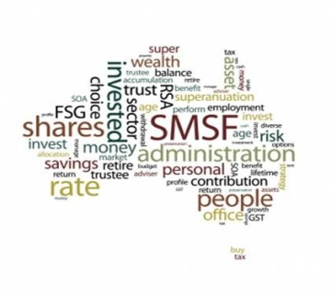
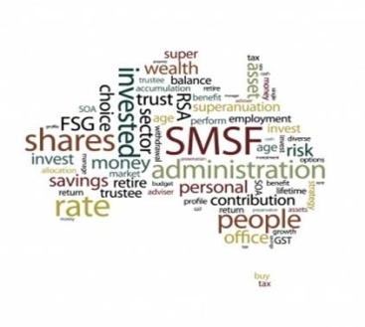
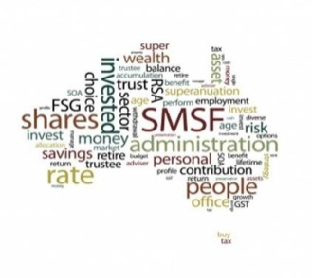
SMSF Auditors Hub – Over 50 Auditors
SMSF Admin Firm
SMSF Admin Firm
SMSF Admin Firm
SMSF Admin Firm
SMSF Admin Firm
SMSF Auditor
SMSF Auditor
SMSF Auditor
SMSF Auditor
SMSF Auditor

Slide 25
For further Enquires
please visit our websites:
www.trustdeed.com.au
www.onlinesmsfaudit.com.au
www.justsign.com.au
and chat with our agent.
Alternatively, you - contact us 0296844199 or
Email us at
sales@trustdeed.com.au
sales@onlinesmsfaudit.com.au
sales@justsign.com.au

